Slide 1
SPORTS With Me
Sports Social Networking App
Overview on what the App hopes to accomplish
Features Implemented in the App
A Demo on How the App works

Slide 2
What the App hopes to Accomplish
Sports With Me is an application that aims to put students in contact with one another to find partners for sports at times when you may not be able to find someone to play with or against.

Slide 3

FEATURES
Google Authentication: Easy and secure login and sign-up via Google.
Customizable Profile: Add photos, select your date of birth, and more during the sign-up process.
Home Screen: View a stack of cards featuring profiles, each displaying the user's name, age, and bio.
Navigation: Easily navigate from the Home screen to the Edit Profile page and the Match List page.
Profile Editing: Update your bio, add or remove photos, select sport preferences, and more.
Match List: See the users you've matched with, indicating mutual interest.
Messaging: Directly message your matches from the Matching screen.

Slide 4
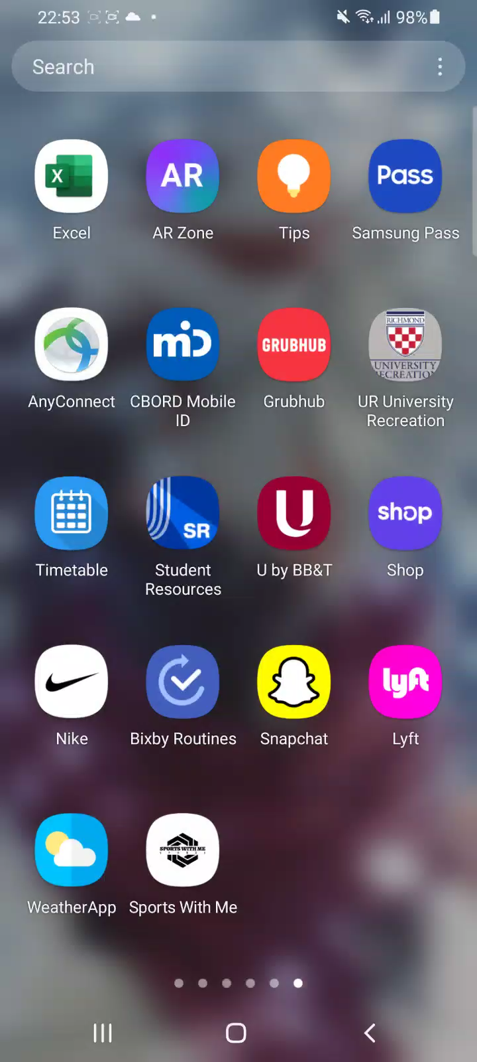
DEMO OF THE APP

Slide 5
CONCLUSION
Thank you for listening

